Slide 1
Image classification using the forward forward algorithm
Using a new ML paradigm for computer vision

Slide 2
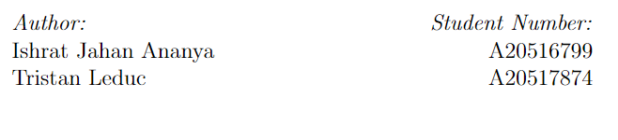

Slide 3
Outline
Context about the emergence of the FF algorithm
Why the backpropagation isn’t perfect
The intuition of the algorithm
The experiments we conducted
Results and analysis
Future prospects

Slide 4
The genesis of the forward forward algorithm principle
New machine learning approach as an alternative to the traditional backpropagation
Introduced by Geoffrey Hinton, a researcher that popularized the idea of backpropagation back in 1986
Would more closely resemble the way our brain processes information
  Because there is little evidence that the brain stores intermediary neuron activation for a subsequent backward pass

Slide 5
What is wrong with backpropagation?
A backpropagation algorithm requires to store intermediary neural activations
The weights can only be updated once the information reaches the last layer (because the error is computed at the end)

Slide 6
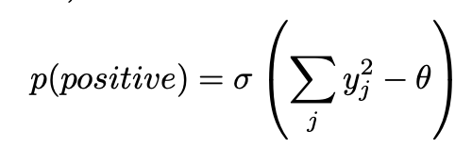
The forward forward algorithm
What the forward forward method consists in
Two passes : a positive pass with data associated to the real label, and a negative pass with data samples associated with wrong labels
Each layer has to discriminate between positive and negative data, using a “goodness” function
  Example of a goodness function :
  The idea is to :
    Maximize the goodness for positive data
    Minimize the goodness for negative data
Where y_j is the activation of the j-th neuron in the layer and sigma is a threshold value

Slide 7
Summary of theoretical advantages of the FF method
No need to propagate the the derivatives across the network
No need to store intermediary activations

Slide 8
The experiments we conducted
Project idea :
Implement the algorithm and ideas to improve the accuracy of the base model on the MNIST dataset
Ways to improve the algorithm
  See the impact of the goodness function on the performance of the model
  See the impact of the architecture of the model (depth=number of hidden layers, width= number of units per layer) on the performance of the model
  Attempt to implement the idea of shared weights
  Alleviate the reliance of the model on uniform backgrounds to overlay the label

Slide 9
Baseline Architecture
Shallow MLP composed of 2 linear layers followed by a sigmoid function, with 500 neurons assigned to each layer. To optimize the model, we employed the Adam optimizer with a learning rate of 0.03. It run for 250 epochs, with 50 internal epochs per layer.
Loss per layer, we calculated it as the sum of the squared neural activities and the negative sum of the squared activities with a threshold of 1.5
Yields test error rate of 0.0207

Slide 10
Experiment on the goodness function : Description
Use the margin loss instead of the sum of squared activities to see if it improves the performance
Because margin loss is known to be more robust to outliers and better at class separation.

Slide 11
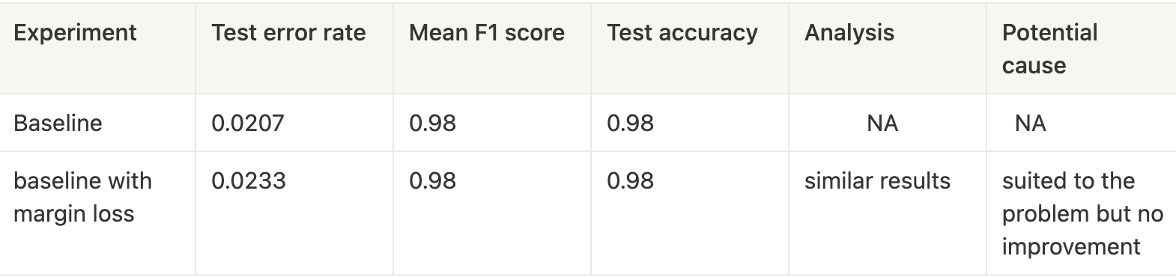
Experiment of the goodness function : Results
Analysis :
Results on par with the baseline, no obvious improvement

Slide 12
Experiment with the model architecture
Tested deeper network with four layers but yields worse results because learned features dont carry well through layers as the input to each layer is normalized everytime
Tested wider network with 200, 800 and even 1200 neurons per layer. Performance was on par with the baseline
Incorporated dropout and a larger than usual learning rate. Loss minimized faster and gave 98% accuracy.

Slide 13
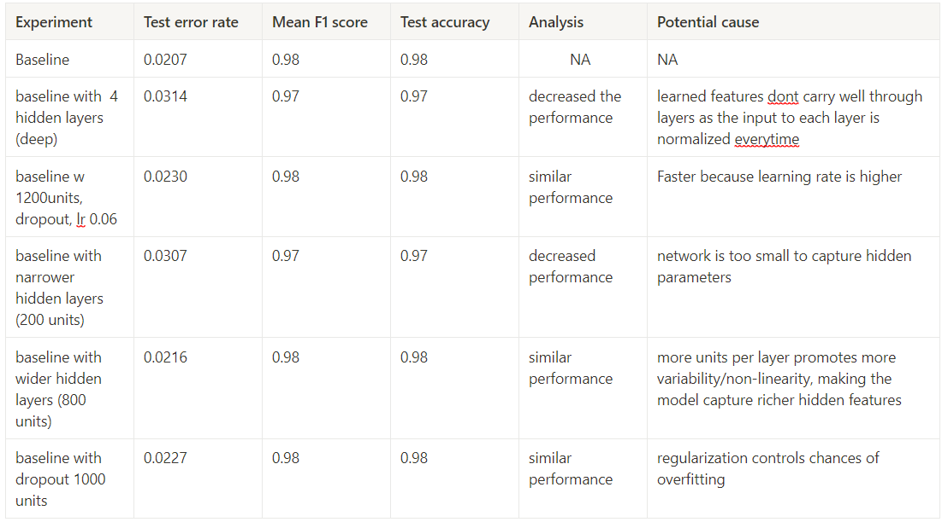
Experiment with the model architecture : Results

Slide 14
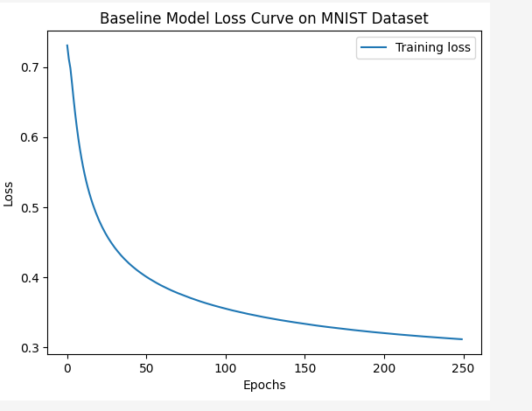
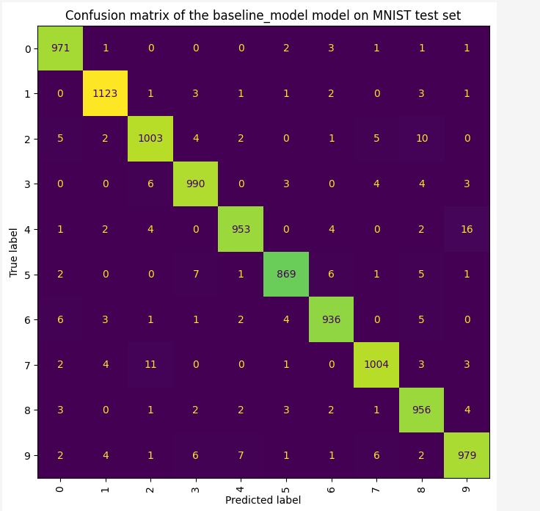
Experiment with the model architecture

Slide 15
Experiment on shared weights : Results
While convolution layers are commonly used in neural networks and have been successful in improving performance in many tasks, it appears that they may not be suitable for this particular model
The implementation was unsuccessful, the forward forward algorithm is not suited to the concept of shared weights
An MLP could be implemented instead

Slide 16
Experiment to alleviate the label problem :Description
Description :
Positive data is created by overlaying the one hot encoded labels on the image matrix
Negative data is created by overlaying a random label on an image that doesn’t correspond to the label
Problem:
Only datasets with uniform background allowed to embed the labels
Solution proposed : embed the label into a new image channel to not interfere with the background of the image

Slide 17
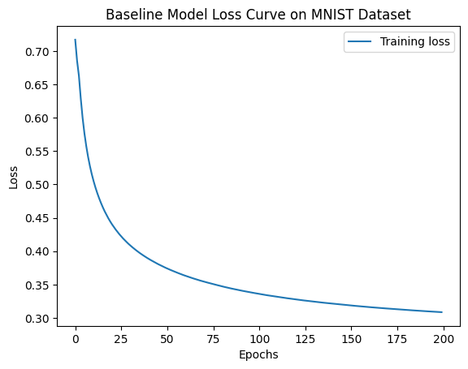
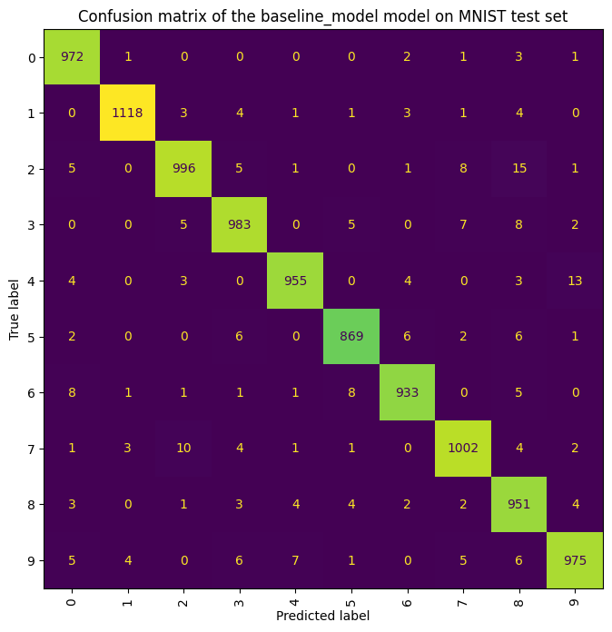

Experiment to alleviate the label problem : Results
Confusion matrix
Training plot

Slide 18
Future Prospects
Can we train the negative images well enough for unsupervised tasks like GAN?
Impact of larger and more complex datasets
Experimenting with other goodness functions that are more suitable

